Slide 1
Sets and Dictionaries
Dr. Rakhee Chhibber

Slide 2
Sets – part 1

Slide 3
Agenda
What is set?
Different ways of creating set
Difference between list and set
Iteration Over Sets
Accessing elements of set
Python Set Methods
Python Set Operations
Union of sets
functions and methods of set
Python Frozen set
Difference between set and frozenset ?
Set Comprehension

Slide 4
What is Set?
A Set in Python is used to store a collection of items with the following properties.
  No duplicate elements. If try to insert the same item again, it overwrites previous one.
  An unordered collection. When we access all items, they are accessed without any specific order and we cannot access items using indexes as we do in lists.
  Internally use hashing that makes set efficient for search, insert and delete operations. It gives a major advantage over a list for problems with these operations.
  Mutable, meaning we can add or remove elements after their creation, the individual elements within the set cannot be changed directly

Slide 5
Creation of Sets
Set literals
The set() constructor
A set comprehension

Slide 6
Creating Sets Through Literals
s = {10, 50, 20}
print(s)
print(type(s))
s1 = {2, 4, 6, 8, 10, 8, 2}
print(S1)
Name ={"Smith", "McArthur", "Wilson", "Johansson", "Smith"}
Lname={'Johansson', 'McArthur', 'Wilson', 'Smith’}
Address={42, "Hi!", 3.14159, None, "Python"}
Print(Address)

Slide 7
Set() Constructor
Example -1
  empty = set()
  Print(empty)
Example -2
  S1= set([1, 2, 2, 3, 4, 4, 5])
  Print(S1)
Example -3
  language = "Python"
  set(language)

Slide 8
Using Set Comprehensions
A set comprehension is a concise way to create a set by evaluating an expression over an iterable. It works similarly to list comprehensions but automatically removes duplicates.
Syntax
{expression for member in iterable [if condition]}
The enclosing brackets ({}) define the set comprehension.
The comprehension expression provides an element in each iteration.
The current member represents the current item or value in the iterable.
The iterable can be any iterable object, including a list, tuple, set, generator, or similar type.
The [if condition] part is an optional conditional that you can use to filter existing collections or generate elements conditionally.

Slide 9
Example
usernames = [ "Alice", " bob", "ALICE ", "Bob", "charlie", "Charlie", "JOHN"]
S1= {name.lower().strip() for name in usernames}
Print(S1)

Slide 10
Check unique and Immutable with Python Set
# Python program to demonstrate that a set cannot have duplicate values and we cannot change its items
# a set cannot have duplicate values
s = {"Geeks", "for", "Geeks"}
print(s)
# values of a set cannot be changed
s[1] = "Hello"
print(s)

Slide 11
Heterogeneous Element with Python Set
# Python example demonstrate that a set can store heterogeneous elements
s = {"Geeks", "for", 10, 52.7, True}
print(s)

Slide 12
Methods for sets
1. Adding elements to Python Sets
# A Python program to demonstrate adding elements in a set
# Creating a Set
people = {"Jay", "Idrish", "Archi"}
print("People:", end = " ")
print(people)
# This will add Daxit in the set
people.add("Daxit")

Slide 13
Adding elements to the set using iterator
# Adding elements to the set using iterator
for i in range(1, 6):
people.add(i)
print("\nSet after adding element:", end = " ")
print(people)

Slide 14
Union operation on Python Sets
# Python Program to # demonstrate union of # two sets
people = {"Jay", "Idrish", "Archil"}
vampires = {"Karan", "Arjun"}
dracula = {"Deepanshu", "Raju"}
# Union using union() # function
population = people.union(vampires)
print("Union using union() function")
print(population)
# Union using "|“ # operator
population = people|dracula
print("\nUnion using '|' operator")
print(population)

Slide 15
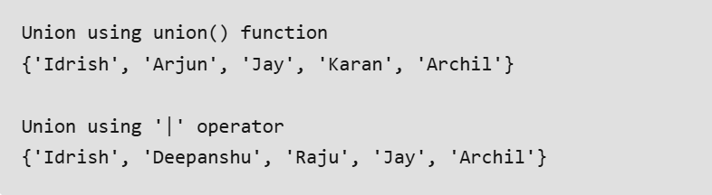
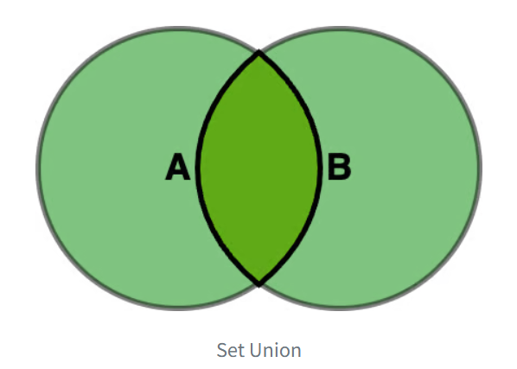
output

Slide 16
Example
pet_animals = {"dog", "cat", "hamster", "parrot"}
farm_animals = {"cow", "chicken", "goat", "dog", "cat"}
pet_animals | farm_animals
farm_animals | pet_animals
pet_animals.union(farm_animals)
farm_animals.union(pet_animals)

Slide 17
Example
a = {1, 2, 3, 4}
b = {2, 3, 4, 5}
c = {3, 4, 5, 6}
d = {4, 5, 6, 7}
a.union(b, c, d)
or
a | b | c | d

Slide 18
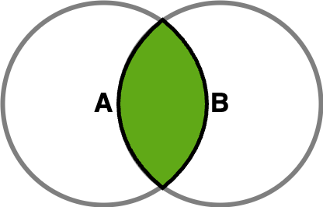
Intersection

Slide 19
Example
john_friends = {"Linda", "Mathew", "Carlos", "Laura"}
jane_friends = {"Alice", "Bob", "Laura", "Mathew"}
john_friends & jane_friends
john_friends.intersection(jane_friends)

Slide 20
Example
a = {1, 2, 3, 4}
b = {2, 3, 4, 5}
c = {3, 4, 5, 6}
d = {4, 5, 6, 7}
a & b & c & d
a.intersection(b, c, d)

Slide 21
# Python program to demonstrate intersection of two sets
set1 = set()
set2 = set()
for i in range(5):
set1.add(i)
for i in range(3,9):
set2.add(i)
# Intersection using # intersection() function
set3 = set1.intersection(set2)
print("Intersection using intersection() function")
print(set3)
# Intersection using # "&" operator
set3 = set1 & set2
print("\nIntersection using '&' operator")
print(set3)

Slide 22
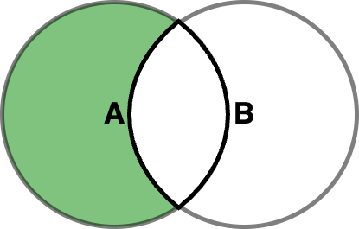
Difference

Slide 23
Example
registered_users = {"Alice", "Bob", "Charlie", "Diana", "Linda"}
checked_in_users = {"Alice", "Charlie", "Linda"}
registered_users - checked_in_users
{'Bob', 'Diana'}

Slide 24
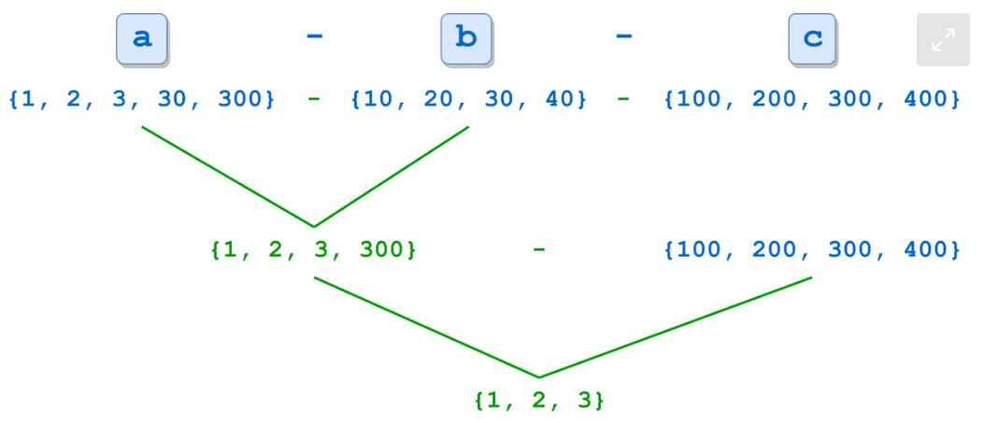
Example
a = {1, 2, 3, 30, 300}
b = {10, 20, 30, 40}
c = {100, 200, 300, 400}
a - b - c
a.difference(b, c)

Slide 25
# Python program to # demonstrate difference # of two sets
set1 = set()
set2 = set()
for i in range(5):
set1.add(i)
for i in range(3,9):
set2.add(i)
# Difference of two sets # using difference() function
set3 = set1.difference(set2)
print(" Difference of two sets using difference() function")
print(set3)
# Difference of two sets # using '-' operator set3 = set1 - set2
print("\nDifference of two sets using '-' operator")
print(set3)

Slide 26
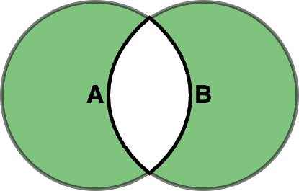
Symmetric Difference

Slide 27
example
morning_attendees = {"Alice", "Charlie", "Linda", "John", "Jane"}
afternoon_attendees = {"Charlie", "Linda", "Bob", "Jane"}
morning_attendees ^ afternoon_attendees
morning_attendees.symmetric_difference(afternoon_attendees)
afternoon_attendees ^ morning_attendees

Slide 28
example
a = {1, 2, 3, 4, 5}
b = {10, 2, 3, 4, 50}
c = {1, 50, 100}
a ^ b ^ c
a.symmetric_difference(b).symmetric_difference(c)

Slide 29
Clearing Python Sets
# Python program to # demonstrate clearing # of set
set1 = {1,2,3,4,5,6}
print("Initial set")
print(set1)
# This method will remove # all the elements of the set set1.clear()
print("\nSet after using clear() function")
print(set1)

Slide 30
Comparing Sets
required_ingredients = {"cheese", "eggs", "milk"}
available_ingredients = {"cheese", "eggs", "milk", "sugar", "salt"}
required_ingredients <= available_ingredients
True
required_ingredients.issubset(available_ingredients)
True

Slide 31
subset
The subset operation lets you determine whether one set is contained in another. You can use the <= operator or the .issubset() method to perform this check.
a = {1, 2, 3, 4, 5}
a <= a
True
a.issubset(a)
True

Slide 32
Proper Subsets
We can determine whether one set is a proper subset of another by using the < operator.
Example
regular_plan = {"Tutorials", "Quizzes"}
premium_plan = {"Tutorials", "Video Courses", "Quizzes", "Books"}
regular_plan < premium_plan
Example
a = {1, 2, 3, 4, 5}
a < a
False

Slide 33
Superset
The superset check lets you determine whether one set contains another. To perform this check, you can use the >= operator or the .issuperset() method.
x1 >= x2
x1.issuperset(x2)
Example
required_ingredients = {"cheese", "eggs", "milk"}
available_ingredients = {"cheese", "eggs", "milk", "sugar", "salt"}
available_ingredients >= required_ingredients
available_ingredients.issuperset(required_ingredients)

Slide 34
Python Set Methods
add() – Adds an element
remove() – Removes element, error if not present
discard() – Removes element, no error if not present
pop() – Removes and returns a random element
clear() – Removes all elements
copy() – Returns a shallow copy
s = {1, 2, 3}
s.add(4)
s.remove(2)
s.discard(5)
print(s) # {1, 3, 4}

Slide 35
Functions and Methods of Set
len(s) → number of elements
max(s), min(s) → largest/smallest element
sum(s) → sum of all elements
sorted(s) → returns a sorted list
all(s) → True if all elements are true
any(s) → True if at least one element is true
s = {5, 10, 15}
print(len(s)) # 3
print(sum(s)) # 30
print(max(s)) # 15

Slide 36
Dictionaries – part 2

Slide 37
Agenda
Operations on Dictionaries
Dictionary Methods
Using for Loop with Dictionaries
Sorting the Elements of a Dictionary using Lambdas
Converting Lists into Dictionary
Converting Strings into Dictionary
Passing Dictionaries to Functions
Ordered Dictionaries
Dictionary Comprehension

Slide 38
Dictionaries
Python dictionary is a data structure that stores the value in key: value pairs. Values in a dictionary can be of any data type and can be duplicated, whereas keys can't be repeated and must be immutable.
Mutable: The dictionary values can be updated in place.
Dynamic: Dictionaries can grow and shrink as needed.
Efficient: They’re implemented as hash tables, which allows for fast key lookup.
Ordered: Starting with Python 3.7, dictionaries keep their items in the same order they were inserted.
The keys of a dictionary have a couple of restrictions. They need to be:
Hashable: This means that you can’t use unhashable objects like lists as dictionary keys.
Unique: This means that your dictionaries won’t have duplicate keys.
    d = {1: 'Geeks', 2: 'For', 3: 'Geeks'}
    print(d)

Slide 39
Create a Dictionary
d1 = {1: 'Geeks', 2: 'For', 3: 'Geeks'}
print(d1)
# create dictionary using dict() constructor
d2 = dict(a = "Geeks", b = "for", c = "Geeks")
print(d2)

Slide 40
Accessing Dictionary Items
d = { "name": "Prajjwal", 1: "Python", (1, 2): [1,2,4] }
# Access using key
print(d["name"])
# Access using get()
print(d.get("name"))

Slide 41
Adding and Updating Dictionary Items
d = {1: 'Geeks', 2: 'For', 3: 'Geeks'}
# Adding a new key-value pair
d["age"] = 22
# Updating an existing value
d[1] = "Python dict"
print(d)

Slide 42
Removing Dictionary Items
del: Removes an item by key.
pop(): Removes an item by key and returns its value.
clear(): Empties the dictionary.
popitem(): Removes and returns the last key-value pair.

Slide 43
d = {1: 'Geeks', 2: 'For', 3: 'Geeks', 'age':22}
# Using del to remove an item
del d["age"]
print(d)
# Using pop() to remove an item and return the value
val = d.pop(1)
print(val)
# Using popitem to removes and returns
# the last key-value pair.
key, val = d.popitem()
print(f"Key: {key}, Value: {val}")
# Clear all items from the dictionary
d.clear()
print(d)

Slide 44
Iterating Through a Dictionary
d = {1: 'Geeks', 2: 'For', 'age':22}
# Iterate over keys
for key in d:
print(key)
# Iterate over values
for value in d.values():
print(value)
# Iterate over key-value pairs
for key, value in d.items():
print(f"{key}: {value}")

Slide 45
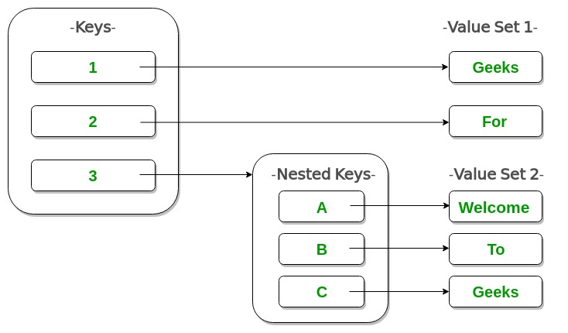
Nested Dictionaries
d = {1: 'Geeks', 2: 'For',3: {'A': 'Welcome', 'B': 'To', 'C': 'Geeks'}}
print(d)

Slide 46
Copying Dictionaries in Python
A copy of a dictionary can be created using either shallow copy or deep copy methods. These methods allow duplicating dictionary objects, but they behave differently when it comes to nested data

Slide 47
1. Shallow Copy
A shallow copy makes a new dictionary with same outer values as the original. But if the dictionary has nested data (like a list or another dictionary), both copies still share that inner data. So, changes to nested parts will affect other.
It is created using copy.copy() method from Python’s copy module.

Slide 48
import copy
original = {'name': 'Alice', 'marks': {'math': 90, 'science': 95}}
# Create a shallow copy
shallow = copy.copy(original)
# Modify nested value in the copy
shallow['marks']['math'] = 100
print("Original:", original)
print("Shallow Copy:", shallow)
Explanation:
shallow = copy.copy(original): creates a shallow copy, nested 'marks' remains shared.
shallow['marks']['math'] = 100: updates 'math' in the shared nested dictionary.
print(original), print(shallow): both show updated 'math' value due to shared data.
Output
Original: {'name': 'Alice', 'marks': {'math': 100, 'science': 95}} Shallow Copy: {'name': 'Alice', 'marks': {'math': 100, 'science': 95}}

Slide 49
2. Deep Copy
A deep copy makes a new dictionary and also creates separate copies of all nested data (like lists or other dictionaries). This means original and copy are completely independent, changes made to nested parts do not affect other.
It is created using copy.deepcopy() method from Python’s copy module.

Slide 50
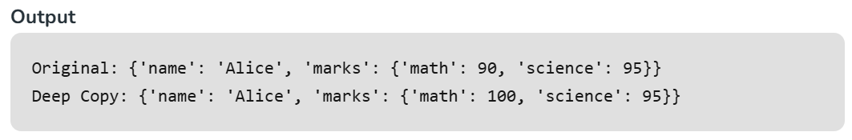
import copy
original = {'name': 'Alice', 'marks': {'math': 90, 'science': 95}}
# Create a deep copy
deep = copy.deepcopy(original)
# Modify nested value in the deep copy
deep['marks']['math'] = 100
print("Original:", original)
print("Deep Copy:", deep)
Explanation:
deep = copy.deepcopy(original): creates a deep copy, nested 'marks' is also copied separately.
deep['marks']['math'] = 100: updates 'math' in the deep copy’s nested dictionary only.
print(original), print(deep): original remains unchanged, only deep copy shows the updated 'math' value.

Slide 51
Python Dictionary Comprehension
Python allows dictionary comprehensions. We can create dictionaries using simple expressions. A dictionary comprehension takes the form
{key: value for (key, value) in iterable}

Slide 52
# Python code to demonstrate dictionary comprehension
# Lists to represent keys and values
keys = ['a','b','c','d','e']
values = [1,2,3,4,5]
# but this line shows dict comprehension here
myDict = { k:v for (k,v) in zip(keys, values)}
# We can use below too
# myDict = dict(zip(keys, values))
print (myDict)

Slide 53
Using fromkeys() Method
dic=dict.fromkeys(range(5), True)
print(dic)

Slide 54
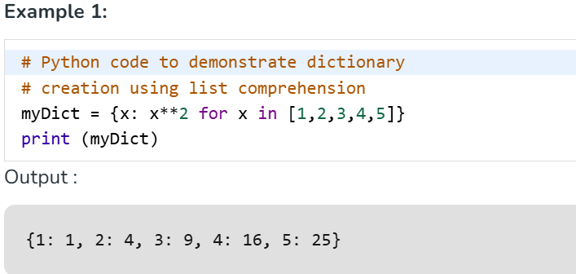
Using dictionary comprehension make dictionary

Slide 55
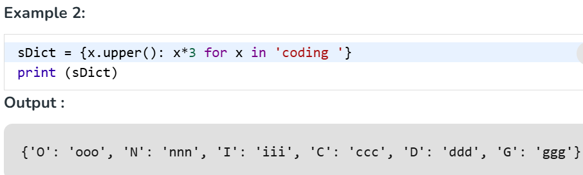

Slide 56
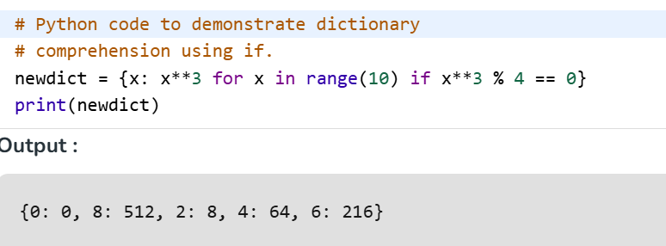
Using conditional statements in dictionary comprehension
Example 1: We can use Dictionary comprehensions with if and else statements and with other expressions too. This example below maps the numbers to their cubes that are divisible by 4.

Slide 57
Python Dictionary Methods
1. Dictionary clear() Method
my_dict = {'1': 'Geeks', '2': 'For', '3': 'Geeks'}
my_dict.clear()
print(my_dict)

Slide 58
2. Dictionary get() Method
d = {'Name': 'Ram', 'Age': '19', 'Country': 'India'}
print(d.get('Name'))
print(d.get('Gender'))

Slide 59
Dictionary keys() Method
d = {'Name': 'Ram', 'Age': '19', 'Country': 'India'}
print(list(d.keys()))

Slide 60
Dictionary update() Method
d1 = {'Name': 'Ram', 'Age': '19', 'Country': 'India'}
d2 = {'Name': 'Neha', 'Age': '22'}
d1.update(d2)
print(d1)

Slide 61
Dictionary values() Method
d = {'Name': 'Ram', 'Age': '19', 'Country': 'India'}
print(list(d.values()))

Slide 62
Dictionary pop() Method
d = {'Name': 'Ram', 'Age': '19', 'Country': 'India'}
d.pop('Age')
print(d)

Slide 63
Dictionary popitem() Method
d = {'Name': 'Ram', 'Age': '19', 'Country': 'India'}
val = d.popitem()
print(val)
val = d.popitem()
print(val)

Slide 64
# Creating a dictionary
student = {"name": "Alice", "age": 22, "course": "Data Science"}
# Access value
print(student["name"]) # Alice
# Add new key-value
student["grade"] = "A"
print(student)
# Update value
student["age"] = 23
# Delete key
del student["course"]
# Check existence
print("age" in student) # True

Slide 65
emp = {"id": 101, "name": "John", "dept": "HR"}
print(emp.keys()) # dict_keys(['id', 'name', 'dept'])
print(emp.values()) # dict_values([101, 'John', 'HR'])
print(emp.items()) # dict_items([('id', 101), ('name', 'John'), ('dept', 'HR')])
# get() method avoids error if key is missing
print(emp.get("salary", "Not Found")) # Not Found
# update()
emp.update({"salary": 50000})
print(emp)
# pop()
emp.pop("dept")
print(emp)

Slide 66
Using for Loop with Dictionaries
fruits = {"apple": 50, "banana": 30, "cherry": 75}
# Iterate keys
for fruit in fruits:
print(fruit)
# Iterate values
for price in fruits.values():
print(price)
# Iterate key-value pairs
for fruit, price in fruits.items():
print(f"{fruit} costs {price}")

Slide 67
Converting Lists into Dictionary
keys = ["id", "name", "salary"]
values = [101, "Raj", 50000]
employee = dict(zip(keys, values))
print(employee)

Slide 68
Converting Strings into Dictionary
import json
data = '{"id": 1, "name": "Sam", "active": true}’
dict_obj = json.loads(data)
print(dict_obj)

Slide 69
Thank you

